Slide 1

Andrew Mwaura
Lecture 1
Distributed Databases - CSC451

Slide 2
Outline
Motivation of Distributed Databases
Distributed Data Processing Vs Distributed Database
Distributed Databases
  Partitioning
  Replication
  Advantages and Disadvantages of Distributed Databases
Distributed Databases - CSC451

Slide 3
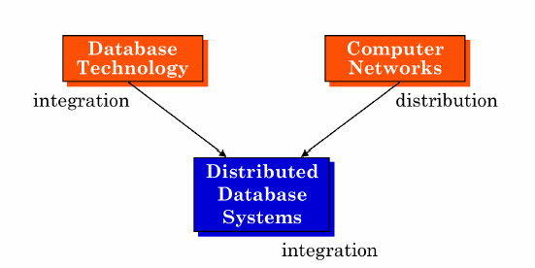
Motivation of Distributed Databases
Distributed Databases - CSC451

Slide 4
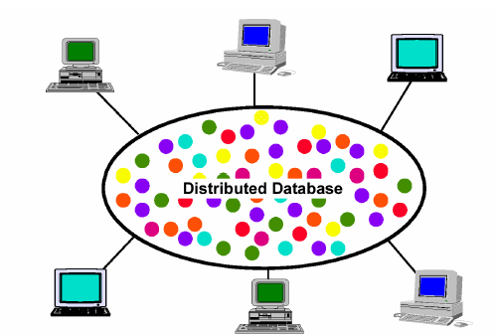
Distributed Database - A User’s View
Distributed Databases - CSC451

Slide 5
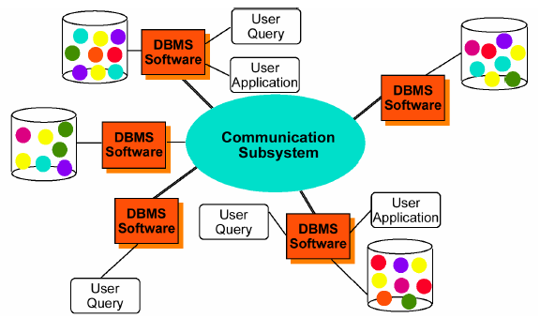
Distributed Database - Reality
Distributed Databases - CSC451

Slide 6
Distributed Database
Applications
  Corporate MIS
  Hotel Chains
  Manufacturing
Distributed Databases - CSC451

Slide 7
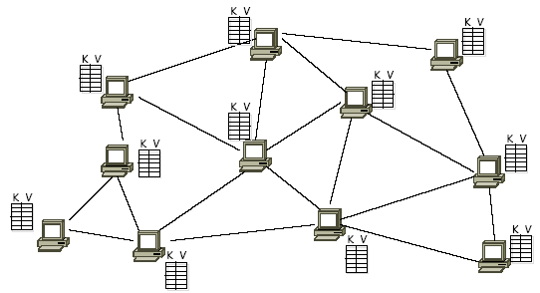
Application
Peer-to-Peer Databases
Distributed Databases - CSC451

Slide 8
Distributed Processing vs Distributed Database
Definition (Distributed Data Processing)
Refers to the deployment of related computing tasks across one or more discreet computing system, or “nodes”.
Nodes may or may not be geographically dispersed
A central processing unit stores data and manages access to that data by the nodes (the “client/server” model).
The central unit, the “server”, stores and manages the data, while the nodes act on it, typically using locally loaded software.
Distributed Databases - CSC451

Slide 9
Distributed Processing…
This has the effect of putting the data under the control of end users, subject to restrictions imposed by the server.
i.e. Distribution of control
Distributed Databases - CSC451

Slide 10
Distributed Processing…
Early distributed data processing systems worked with a single centralized database.
Smaller local systems started to store local databases as well as do local data processing.
Move to central database distributed to local processors as long as:
  Accurate updating of data
  Integrity of Data
  Sharing of Data
  Central Administrative controls
Could all be assured and maintained
Distributed Databases - CSC451

Slide 11
Distributed Processing
Why is DDP Increasing?
Dramatically reduced workstation costs
Improved user interfaces and desktop power
Ability to share data across multiple servers
Distributed Databases - CSC451

Slide 12
Distributed Database
Definition (DDB)
A distributed database (DDB) is a collection of multiple, logically interrelated databases over a computer network
Distributed Databases - CSC451

Slide 13
Distributed Database…
Definition (D-DBMS)
A distributed database management system (D-DBMS) is the software that manages the DDB and provides an access mechanism that makes the distribution transparent to users
Distributed Database System (DDBS) = DDB + D-DBMS
Distributed Databases - CSC451

Slide 14
Distributed Database…
Consists of a collection of data with different parts under the control of separate DBMSs running on independent computer systems.
Parts (Partition d/b) or copies (Replicated d/b) are physically stored in one location and other parts or copies are stored and maintained in other locations
All the computers are interconnected and each system has autonomous processing capability serving local applications
Distributed Databases - CSC451

Slide 15
Distributed Database
Data in a distributed DBMS can be
  (a) Partitioned or
  (b) Replicated
  (c) or both
Distributed Databases - CSC451

Slide 16
Distributed Database
(a) Data partitioning
In a distributed DBMS a relational table may be broken up into two or more non-overlapping partitions or slices.
A table may be broken up horizontally, vertically, or a combination of both.
Partitions may in turn be replicated. This feature causes problems for concurrency control and catalogue management in distributed databases.
Partitioning is transparent to users.
Distributed Databases - CSC451

Slide 17
Distributed Database
(b) Data replication
In a distributed DBMS a relational table or a partition may be replicated or copied, and copies may be distributed throughout the database.
This feature can cause problems for propagating updates and concurrency control
Is transparent to users in distributed databases
Distributed Databases - CSC451

Slide 18
Distributed Database
Advantages
Capacity and incremental growth
Reliability and availability
Improved performance
Improved shareability and local autonomy
Distributed Databases - CSC451

Slide 19
Distributed Database
Capacity and incremental growth
  As the organisation grows, new sites can be added with little or no change to the DBMS
  Does not involve upgrading with changes in hardware and software that effect the entire database
Reliability and availability
  Even when a portion of a system (i.e. a local site) is down, the overall system remains available
  With replicated data, the failure of one site still allows access to the replicated copy of the data from another site
  The greater accessibility enhances the reliability of the system.
Distributed Databases - CSC451

Slide 20
Distributed Database
Improved performance
  Data is physically stored close to the anticipated point of use
  If usage patterns change then data can be dynamically moved or replicated to where it is most needed
Improved shareability and local autonomy
  users at a given site are able to access data stored at other sites and at the same time retain control over the data at their own site.
Distributed Databases - CSC451

Slide 21
Distributed Database
Disadvantages …
  Increased Cost
  Complexity
  Security
  Integrity control may be difficult
Distributed Databases - CSC451

Slide 22
Distributed Database
Increased Cost
  Implementation are its cost and complexity
  Maintenance costs of the system are higher
  Large communication overhead in coordinating messages between the different sites
Security
  Security risk is high
  Needs secure network communication
Distributed Databases - CSC451

Slide 23
Distributed Database
Complexity
  A distributed system, which hides its distributed nature from the end user, is more complex than the centralised system
  The parallel nature of the system means that errors are harder to avoid and those in the applications are difficult to pinpoint
Integrity control may be difficult
  Validity and consistency of stored data
  Communication and processing cost required to enforce the integrity constraints may be significant in some situations
Distributed Databases - CSC451

Slide 24
Summary
Motivation of Distributed Databases
Distributed Data Processing Vs Distributed Database
Distributed Databases
  Partitioning
  Replication
  Advantages and Disadvantages of Distributed Databases
Distributed Databases - CSC451

